Slide 1
Art Buddy
Done by : Brendan Yeo

Slide 2

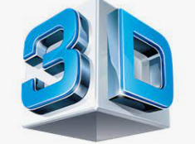

Overview
Project Scope | 3D Designs
Code | Summary

Slide 3
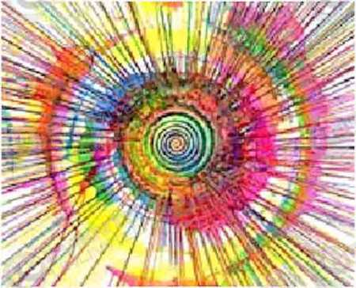
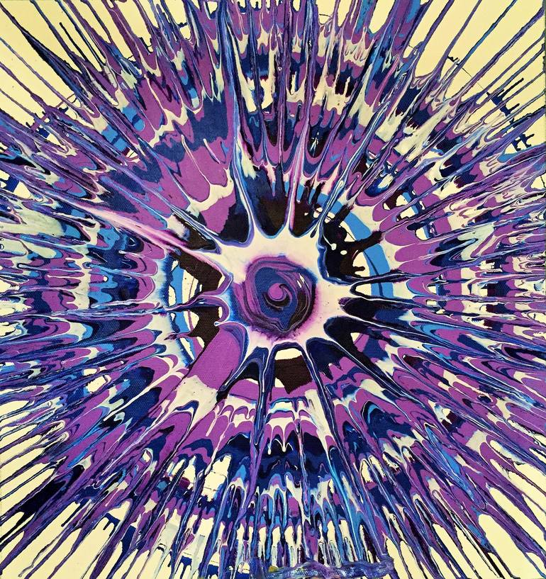
What is Art Buddy ?
Integration of Art with Engineering
Creating a machine prototype to assist in creation of masterpiece
Spinning Art Assistance

Slide 4
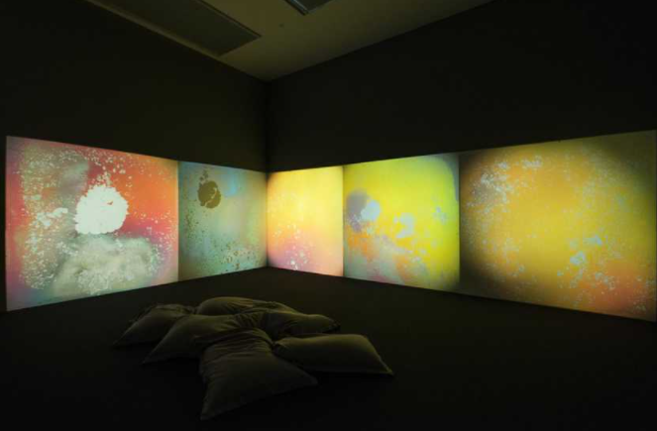
Introducing Technology in Arts
GusTav Metzger
Auto Creation of Art in Liquid Crystal environment
Heating and cooling using computer program

Slide 5

Introducing Technology in Arts
Eric Standley
Create stained glass window using laser-cut paper
3D effect to art work

Slide 6
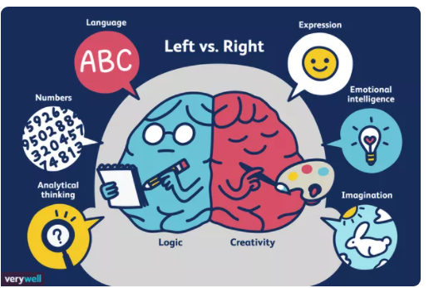
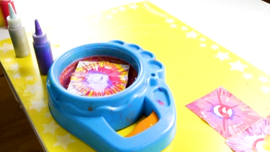
Benefit
Widen artistic vision
Left and Right brain
Logical and Creativity

Slide 7
Objective
Create a prototype
3D design
Coding ( C programming )

Slide 8
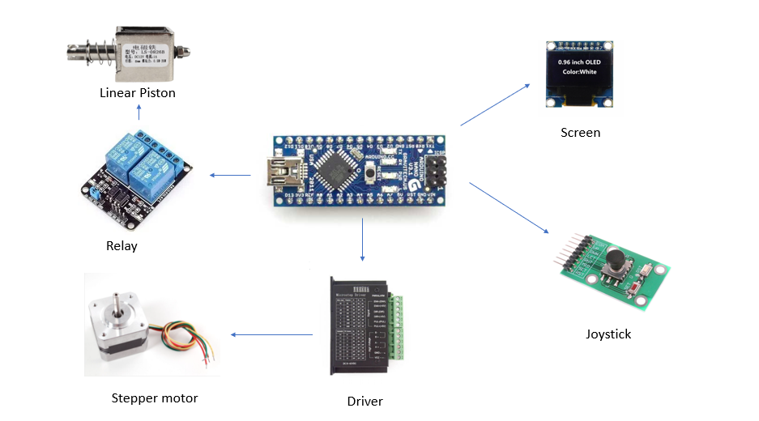
Equipments

Slide 9
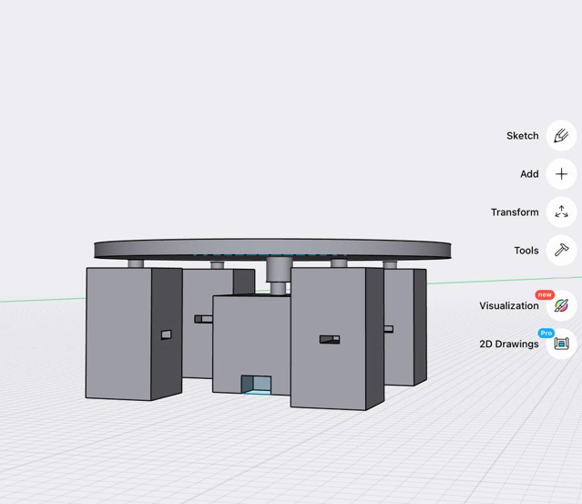

Slide 10
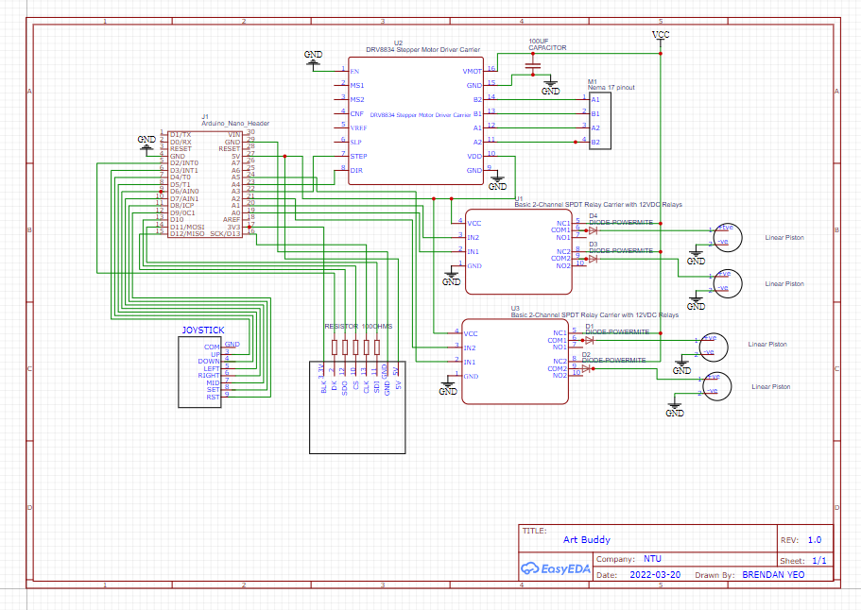
Schematic Diagram

Slide 11
3D Design Components
Table
Table stand
Stepper Motor Holder
Linear Motor Holder

Slide 12
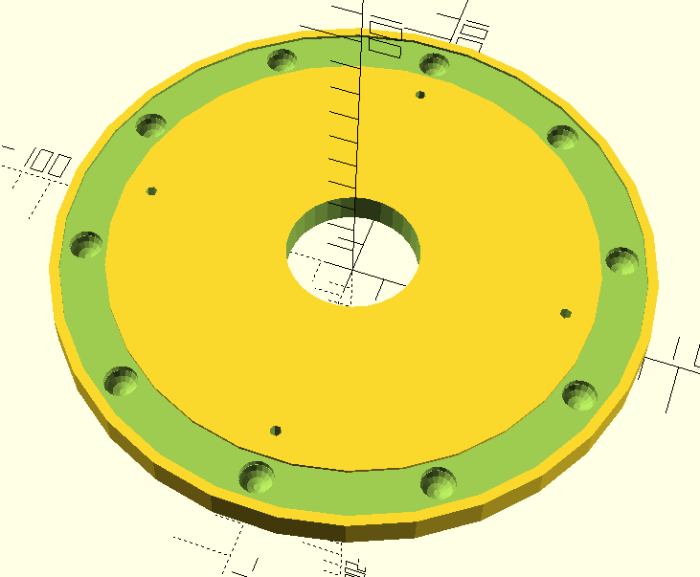
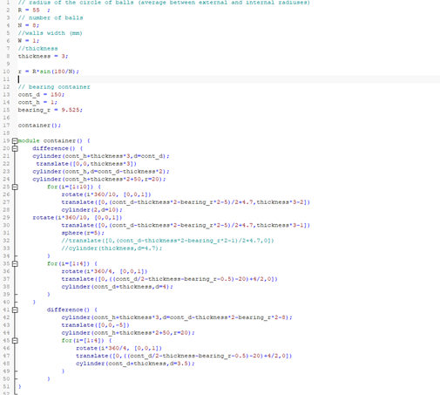
3D Design (Table)

Slide 13
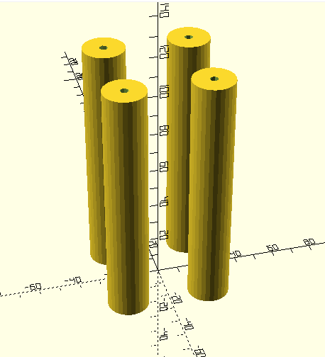
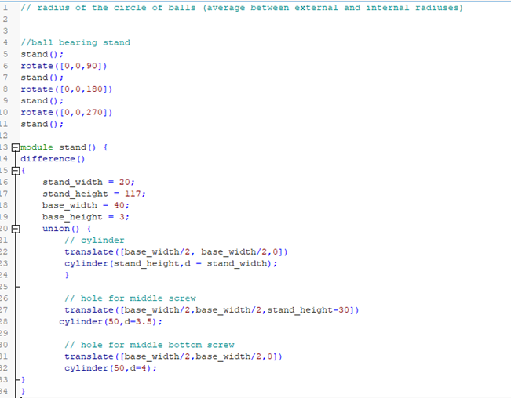
3D Design (Table stand)

Slide 14
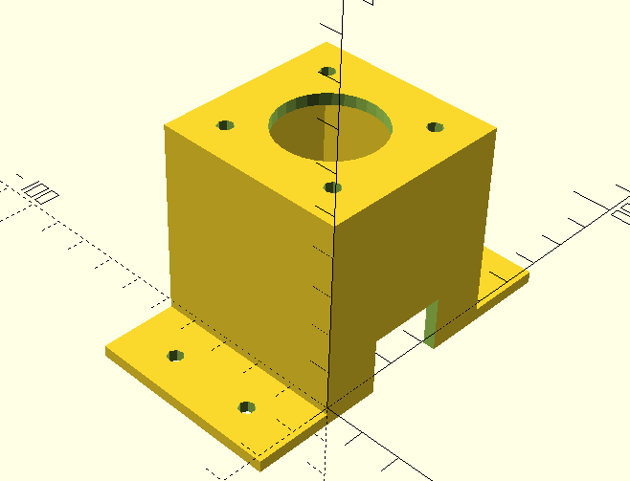
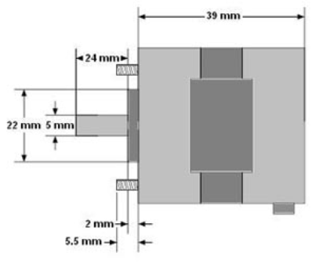
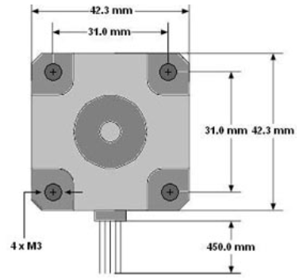
3D Design (Stepper Motor Holder)

Slide 15
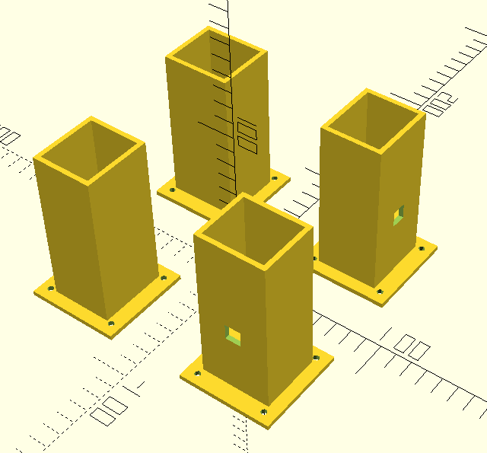
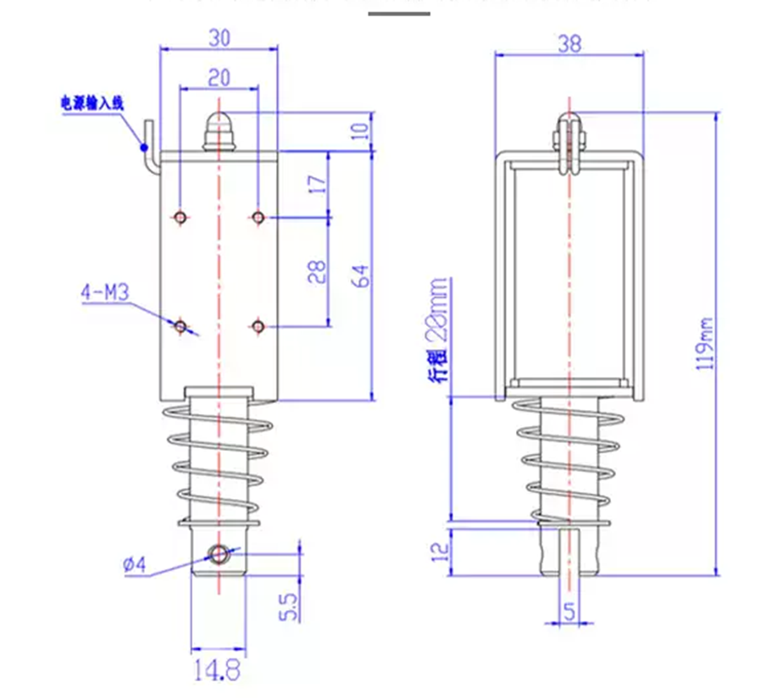
3D Design (Linear Motor Holder)

Slide 16
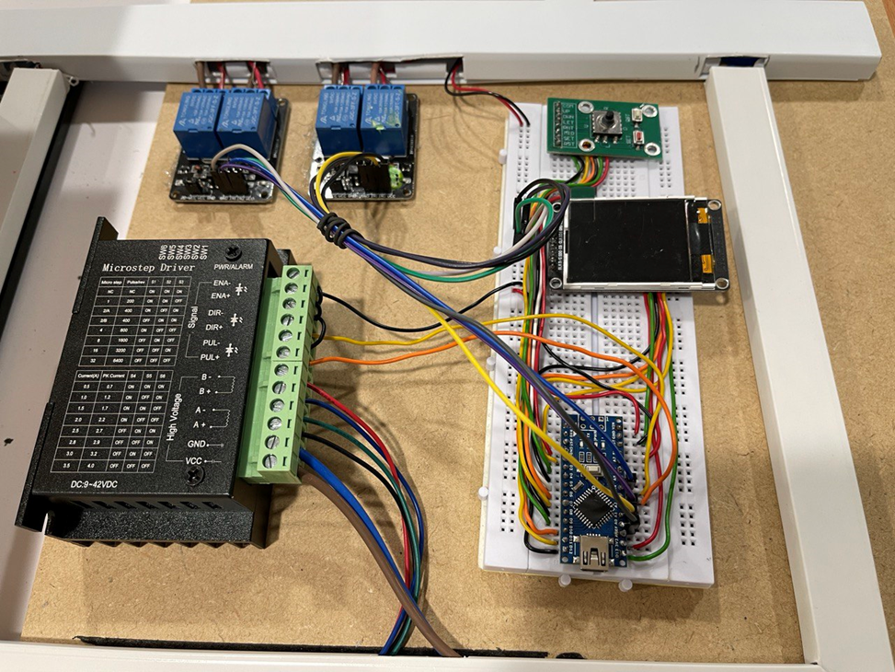
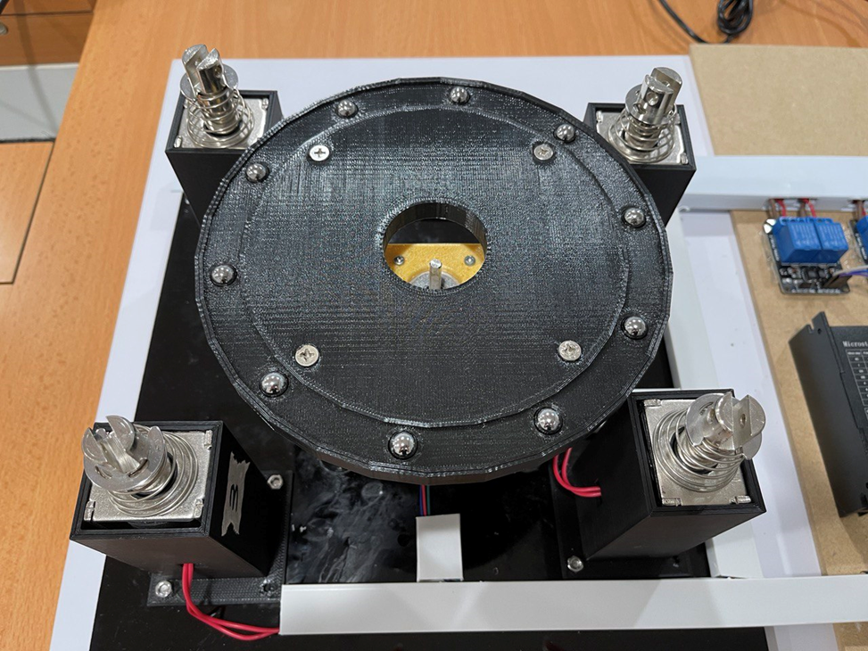
Prototype

Slide 17
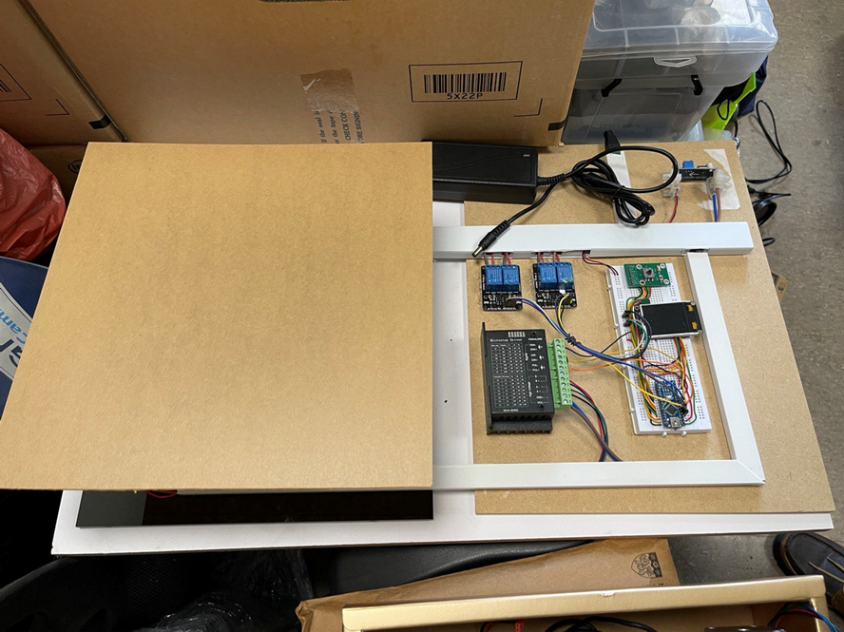
Prototype

Slide 18
Code
Requirement Gathering
UI/UX Design
Function for joystick movement
Function for Stepper motor
Function for Linear Motor

Slide 19
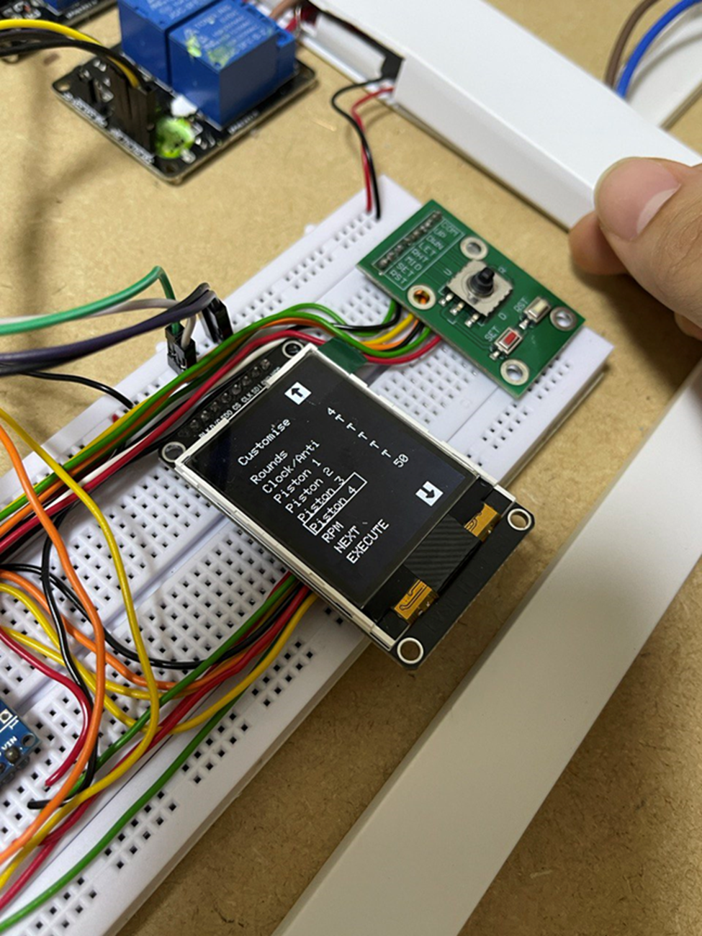
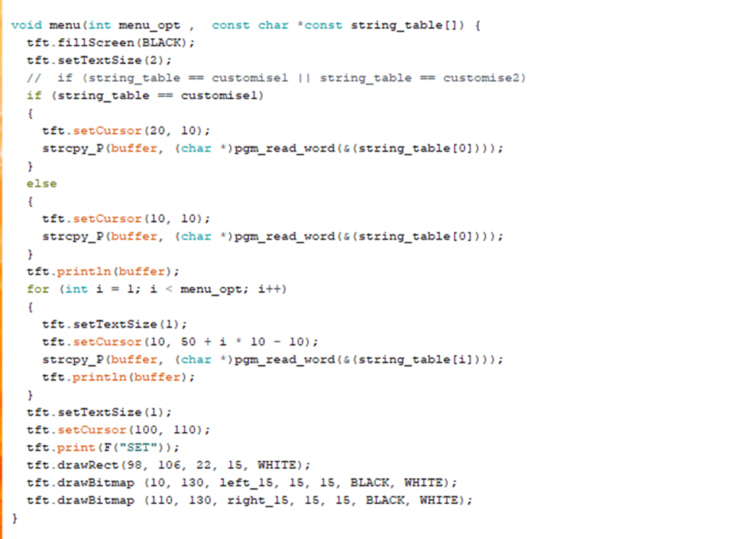
Code (UI/UX Design)

Slide 20
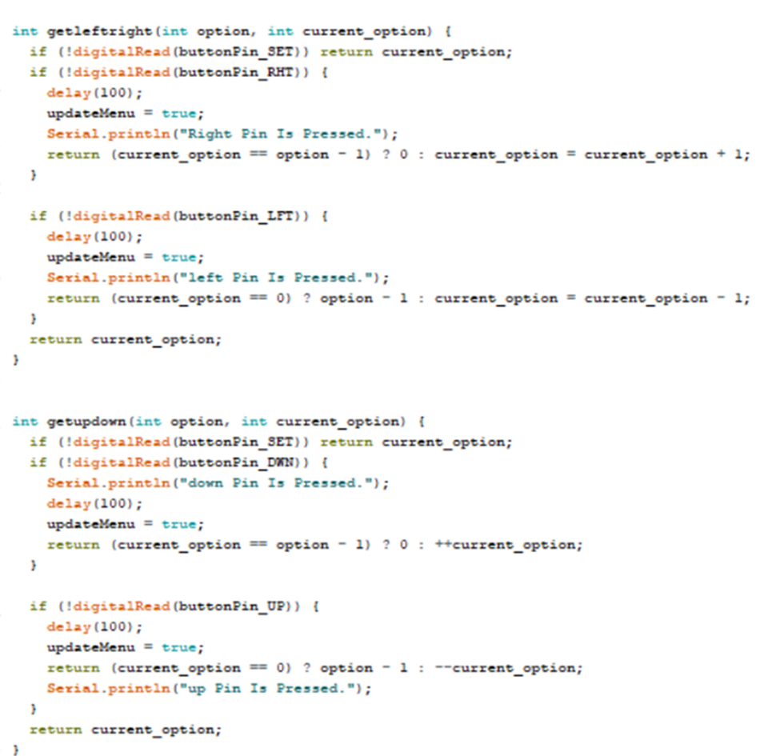
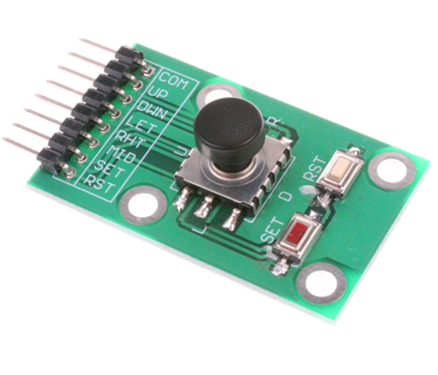
Code (Joystick)

Slide 21
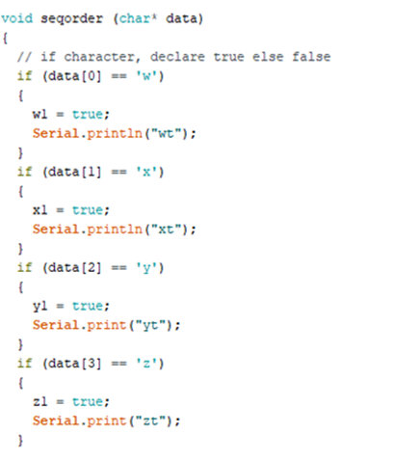
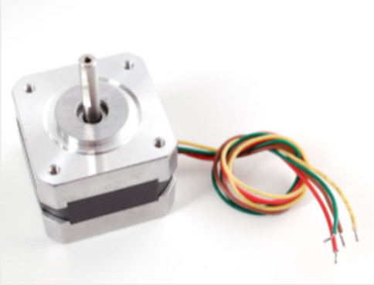
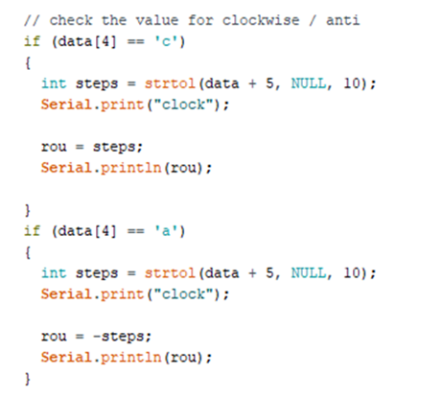
Code (Stepper Motor)

Slide 22
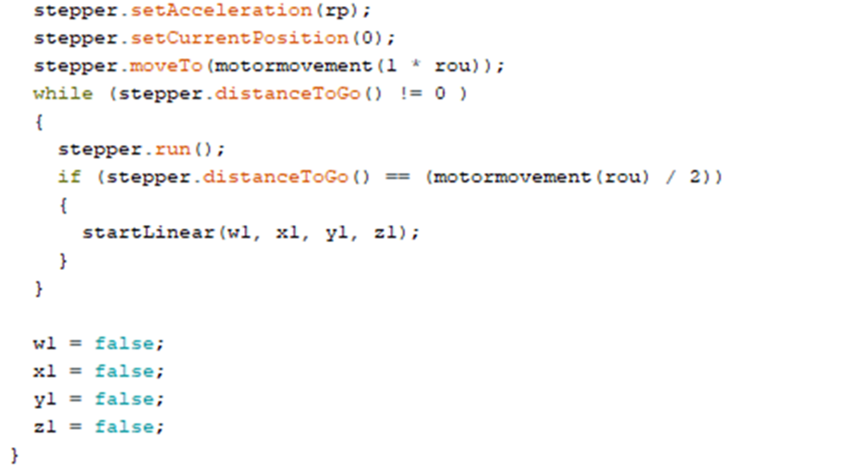
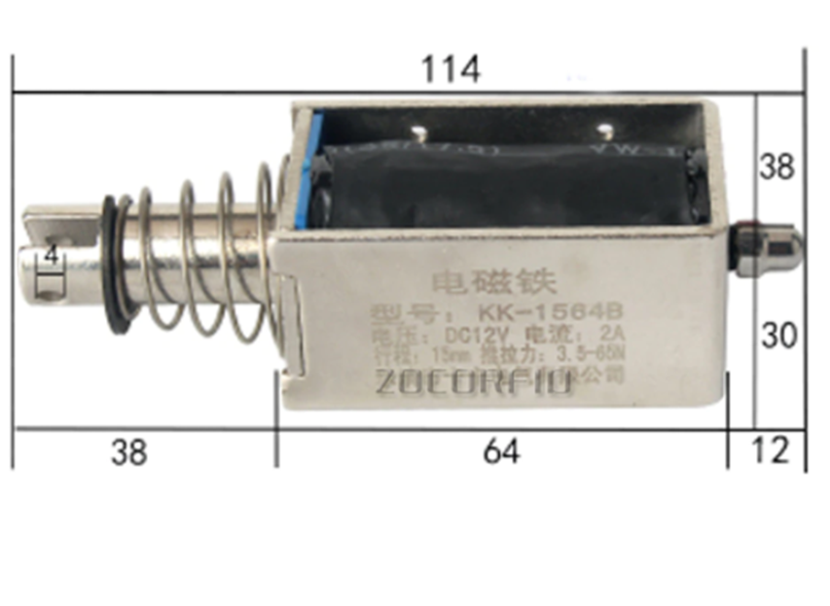
Code (Piston)

Slide 23
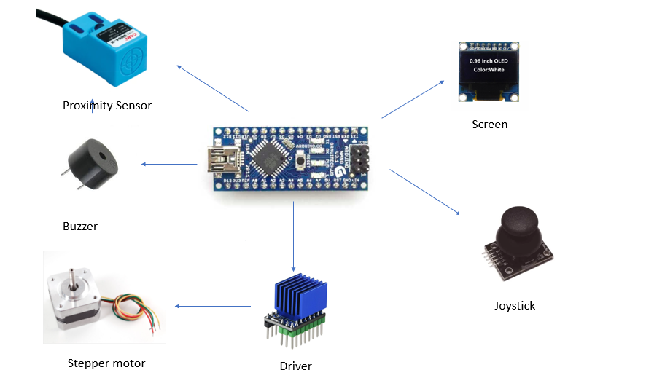
Art Buddy II

Slide 24
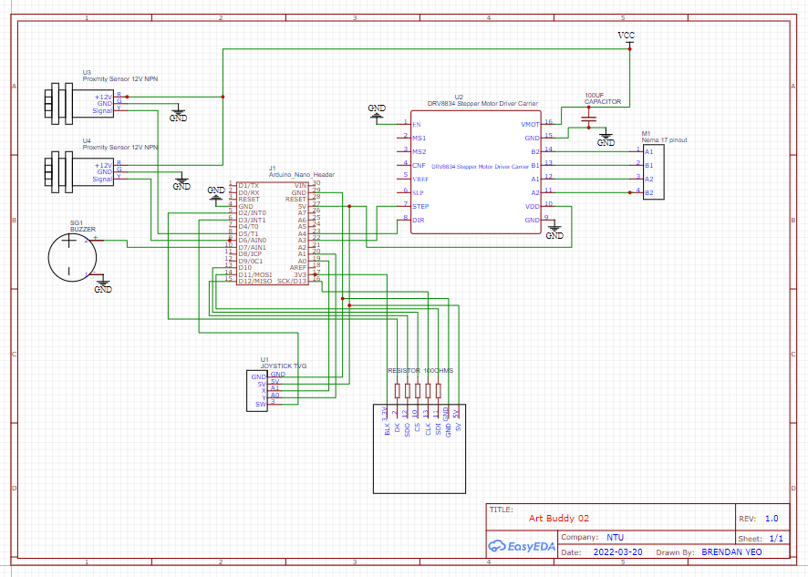
Schematic

Slide 25
Art Buddy II

Slide 26
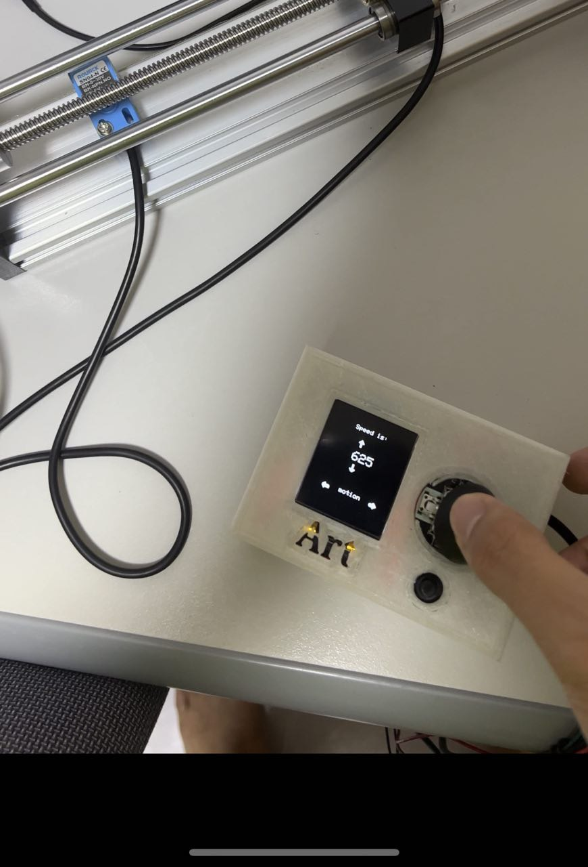
Design

Slide 27
Code
Requirement Gathering
UI/UX Design
Function for Automatic Activation
Function for Manual Activation

Slide 28
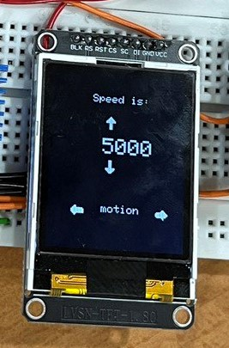
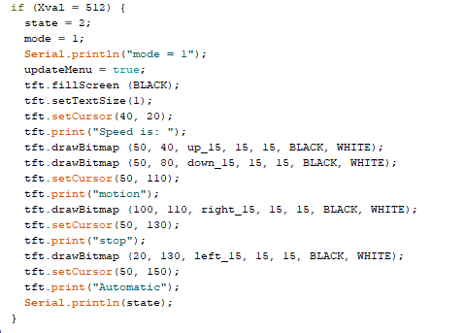
Code (UI/UX Design)

Slide 29
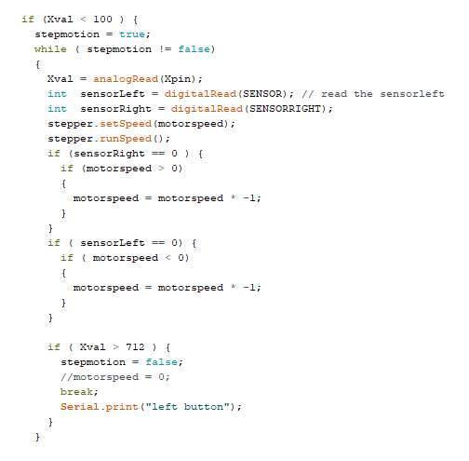
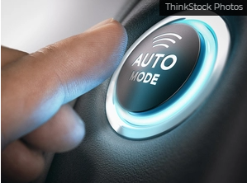
Code (Automatic Activation)

Slide 30
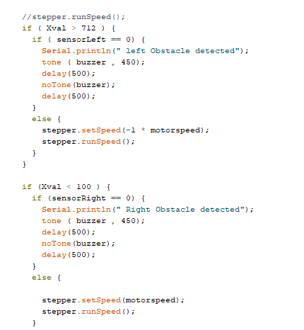

Code (Manual Activation)

Slide 31
Learning point
Exposure to creating prototype
Thinking process
Execution of the project

Slide 32
Reference
[1] “How technology is changing the Art World,” ARTDEX, 31-Jul-2020. [Online]. Available: https://www.artdex.com/how-technology-is-changing-the-art-world-2/#:~:text=We%20have%20already%20mentioned%20Andy,the%20pioneers%20of%20digital%20art. [Accessed: 22-Feb-2022].
[2] A. Pietrangelo, “Left brain vs. right brain: What's the difference?,” Healthline, 08-Mar-2019. [Online]. Available: https://www.healthline.com/health/left-brain-vs-right-brain#left-brainright-brain-theory. [Accessed: 22-Feb-2022].

Slide 33
Thank you

